Slide 1

Wolbachia, Dengue Fever and Randomized Test-Negative Studies
Jerome Johnson
Supervised by Nick Jewell

Slide 2
Background
From the “Applying Wolbachia to Eliminate Dengue” (AWED) trial carried out in Yogyakarta City, Indonesia which ran from Jan 2018 to May 2020
Dengue virus is transmitted via Aedes Aegypti mosquitoes
Aedes Aegypti mosquitoes infected by Wolbachia bacteria block the dengue virus from being transmitted, with bacteria being maternally inherited
AWED trial design was a cluster randomized intervention trial – dividing Yogyakarta city into 24 regions
Intervention was deployment of Wolbachia infected mosquitoes into a region

Slide 3
Background
12 regions received intervention with pulses of Wolbachia mosquitoes being placed into the wild over a period of months, other 12 regions receiving nothing
Patient participation to measure efficacy involved patients going to government-run clinics if they had symptoms related to dengue, aged 3-45 years, and were in that area for 10 days prior to symptom onset
Excluded if they were already enrolled in study within 4 weeks, or if their symptoms suggested other diagnoses not including arboviral infection
Test-negative aspect comes from patients being “controls” if they tested negative for dengue + other viruses, and were “cases” if tested positive

Slide 4
Background
Efficacy was measured by comparing aggregated odds of residence in a Wolbachia-treated cluster between dengue cases and controls
Results for ITT analysis showed Wolbachia deployments were associated with 77.1% (95% CI 65.3, 84.9) reduction in dengue case incidence

Slide 5
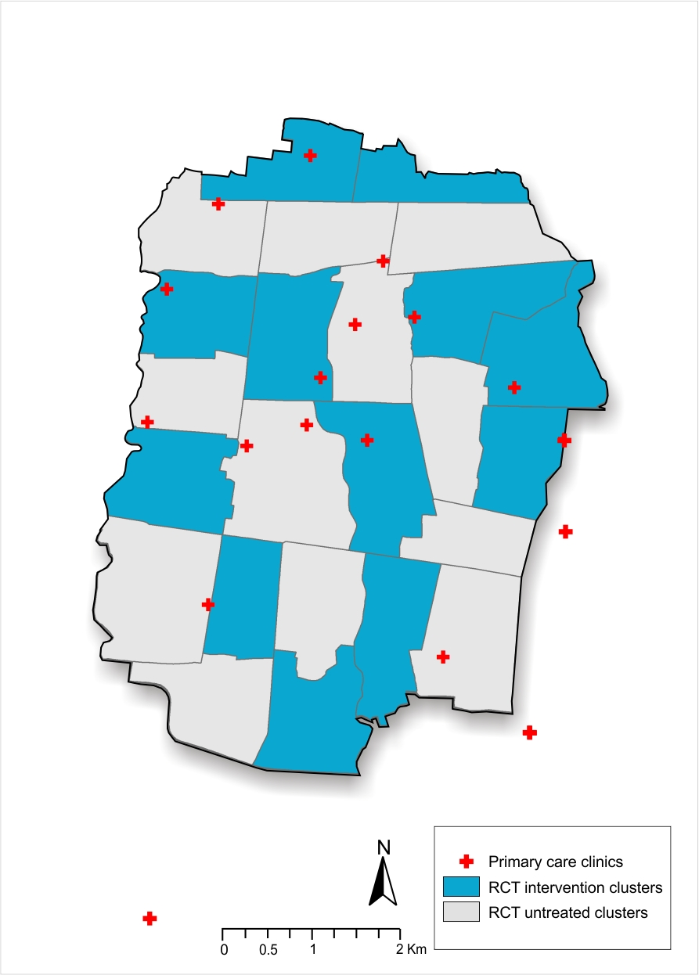
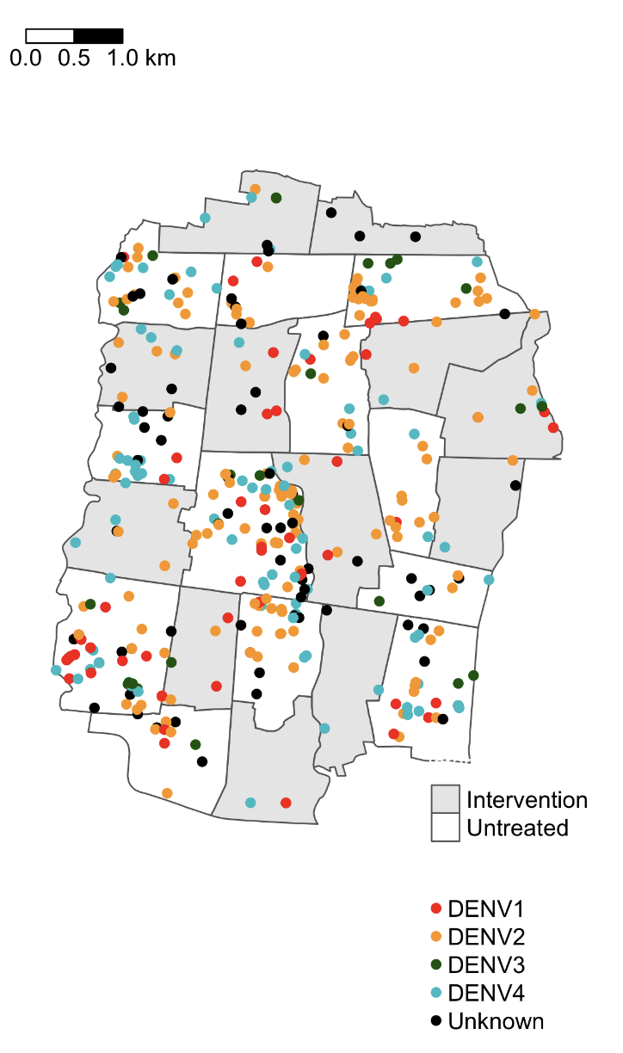
Project Aims
Analyse how intervention efficacy evolves over time as control contamination with Wolbachia increases, since patient enrolment was from Jan 2018 to March 2020
Compare the spatial clustering of dengue infections across intervention and control areas
Examine performance of statistical efficacy estimates for specific dengue sub-strains (4) where data becomes more sparse

Slide 6
Methods
Spatial clustering analysis of dengue incidence data
Use statistical methods to quantify spatial-temporal clustering, being applied to AWED data and then compared using simulated incidence data
How to assess the variance of estimation of these measures

